Slide 1



INTERACTIVE TO DO LIST
PROJECT MEMBERS :
MOHAMMED YUNUS A - 23ITR064
MATHAN M - 23ITR063
KARTHICK SARAVANAN R M - 23ITR119
JAIHARI D
(19ITR028)

Slide 2
Objectives
To develop an interactive to-do list website that enhances task management through an intuitive and user-friendly interface.
Creates an interactive to-do list website that helps users manage task efficiency.
Focus on usability, responsiveness, and productivity features.
2

Slide 3
Introduction
An interactive to-do list website is a digital tool that allows users to efficiently manage their tasks, set priorities, and track progress in an organized way. Unlike traditional paper-based lists, it provides real-time updates, data persistence, and a user-friendly interface for seamless task management.

Slide 4
Problem Statement
Many people struggle with task management and productivity.
Traditional paper-based lists lack flexibility.
Existing solutions might be complex for basic users.
Need for a simple, interactive, and user-friendly task management system.

Slide 5
Software / Hardware Tools used
Software Requirements
Programming Language - HTML, CSS, JavaScript
Frontend
HTML , CSS , JavaScript.
Database
MySQL.
5

Slide 6
Modules
Task Management Module
Due Date & Reminder Module
Notification & Alert Module
Login/Signup module

Slide 7
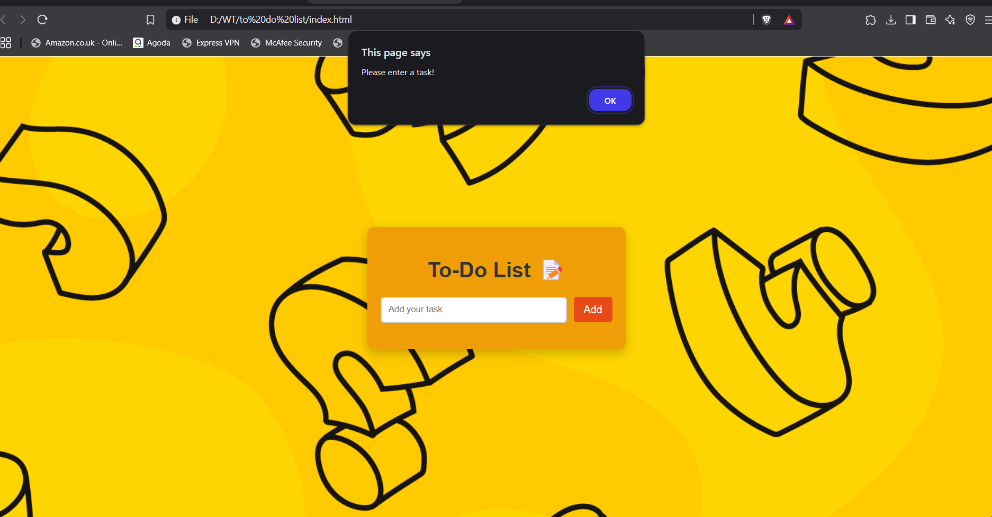
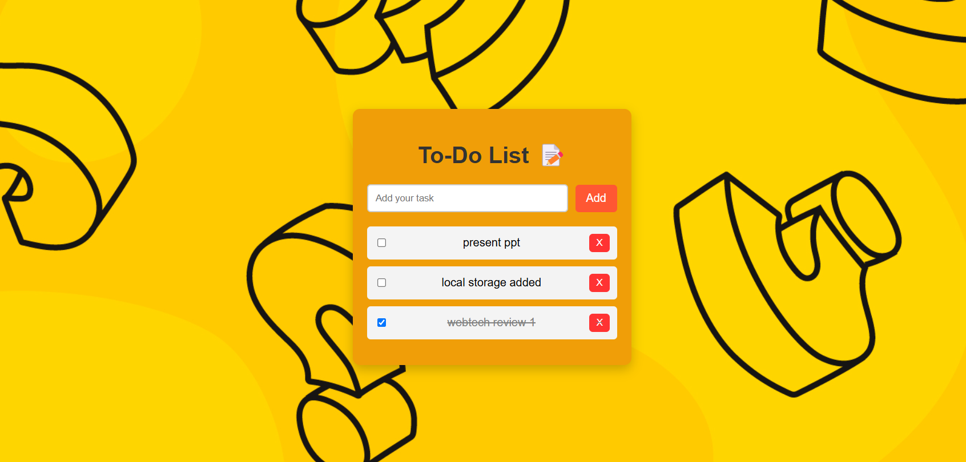
Modules

Slide 8
References
CSS Styling Guide - https://www.w3schools.com/css/
HTML Forms & Inputs - https://www.w3schools.com/html/html_forms.asp
Sample websites - https://www.todoist.com/
SQL Tutorial-https://www.geeksforgeeks.org/sql-tutorial/?ref=gcse_ind

Slide 9
Thank you!

